Slide 1

STAT-515 Redesign Project
Jungbin Ahn
By- Group 10
Jungbin Ahn
Raghuveer Reddy Kalvakole
Sai Chaitanya Sadasivuni

Slide 2
Change in the US population from 2010-2019

Slide 3

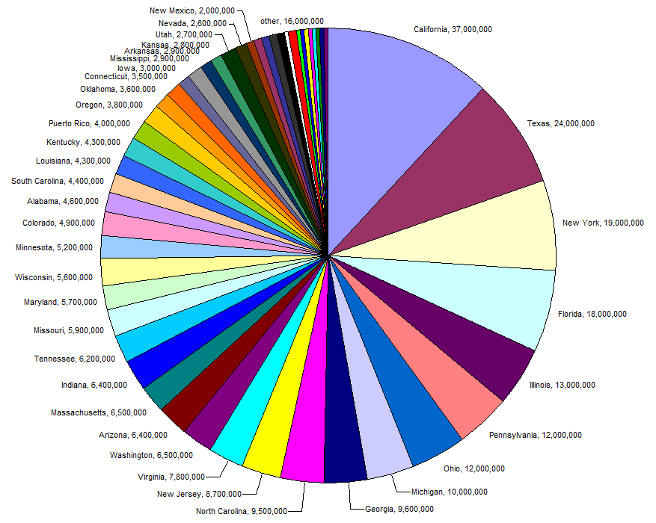



Original Graph
This graph doesn’t seem to be clear because the population rates of a few states is not clear and there is no information about the change in population rate in the years 2010-2019.
It does not follow good visualization practices and has no clear labelling and a few states in the graph have no exact number of people and is mentioned as others.

Slide 4
Dataset Description
Name – Name of the states
CENSUS2010POP – Population count in 2010
POPESTIMATE2019 – Population count in 2019
2019-2010 – Change in population from 2010 to 2019
Proportion – Distribution of population among the states.

Slide 5
Libraries used:
Tidyverse – This package is designed to make it easy to install and load multiple 'tidyverse' packages in a single step. It is an opensource package available in R Studio which is used for visualization plots.
MicromapST – This package is used to create linked micromapST and visualizations for geographical plots. MicromapST give a way to condense and show both factual and geographic conveyances by connecting factual rundowns to a progression of little maps

Slide 6
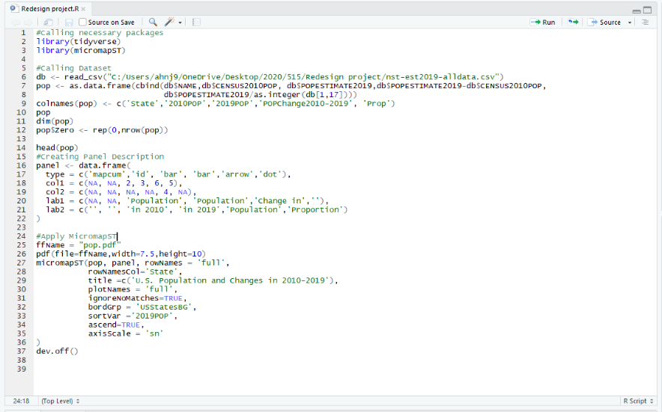
Code

Slide 7
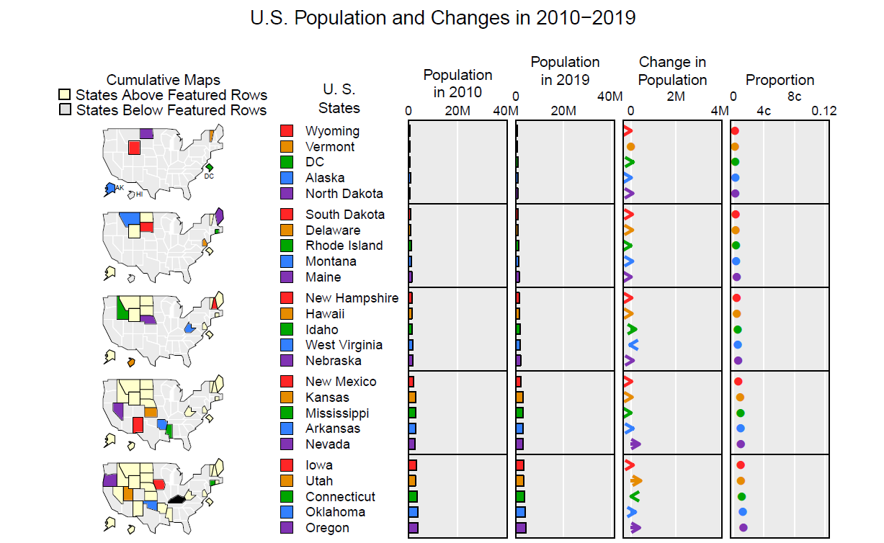
New Graph

Slide 8
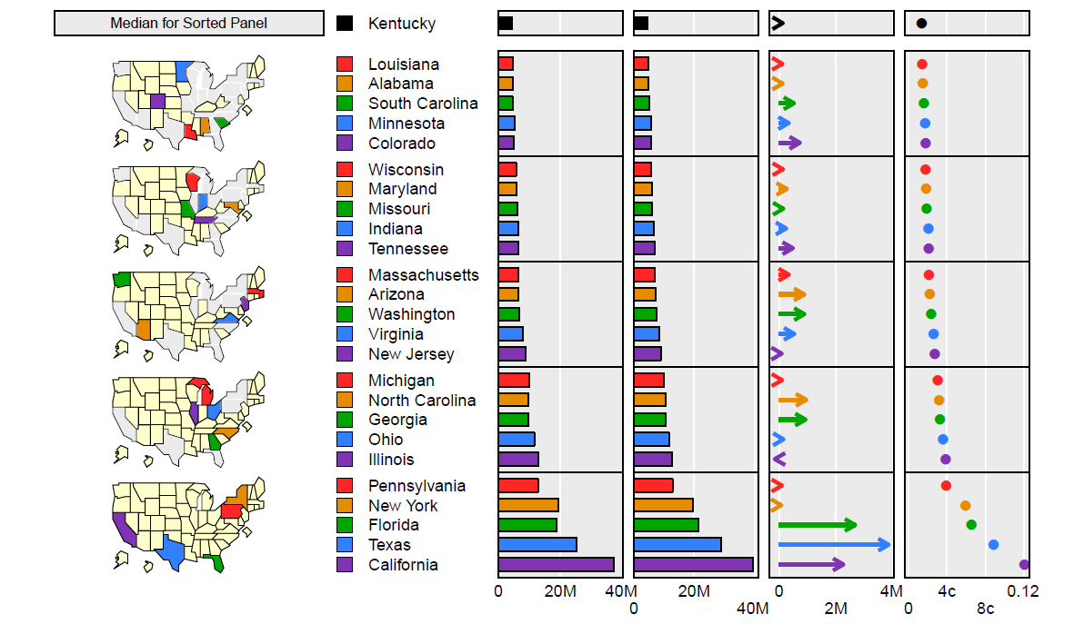

Slide 9
Outcomes From New Graph
The new graph is clearer than the previous bad graph and explains the change in population in the years 2010-2019.
It shows the proportion of population in each state which is the original purpose of the pie chart.
It follows good visualization practices when compared to the ones in the bad graph.

Slide 10
Thank You!
Questions ?

